Slide 1
Health and safety

Slide 2

Contents
Health and Safety
Existing System
Problems with Existing System
Research Question and Proposal
Measurable Organisational Value
Scope, Aim and Objectives
Existing Applications
Software Technologies and Methodology
Gantt Chart
What’s Next?
Conclusion and Questions
References
Retrieved From: https://www.dreamstime.com/stock-illustration-safety-work-concept-word-cloud-illustration-tag-image45418712

Slide 3
Health and Safety
Guidelines and processes that are implemented within a place of work or communal environment to avoid accident or injury (Health and Safety, n.d.)
Health and Safety at Work Act 2015
Everyone is responsible for health and safety

Slide 4
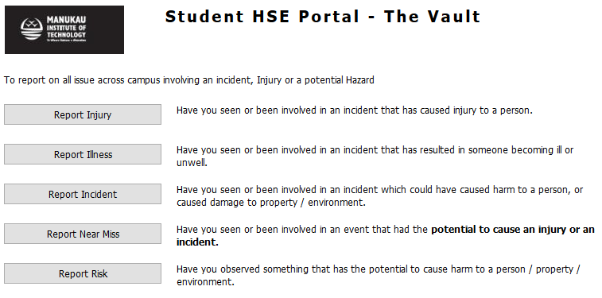
Existing System
Only available for staff on the employee intranet
New staff required to view this when first employed
Questionnaire required and documented
Incident reporting tool available for staff and students

Slide 5
Problems with existing system
No access for students
No health and safety briefing
No follow-up meetings on health and safety
No instructions on reporting tool location
Time consuming and easily forgotten

Slide 6

Research question and Proposal
Interactive Android mobile application and website available for students and visitors
Health and safety video
Can a mobile application improve awareness of health and safety for students at the Manukau Institute of Technology?
Retrieved from: https://worldvectorlogo.com/logo/get-it-on-google-play

Slide 7

Measurable Organisational Value
Social and Customer Impact
Students important for New Zealand’s future
50% reduction of student incidents
Awareness for students, especially international

Slide 8
Scope, Aim and Objectives
Scope – Health and safety awareness more accessible
Aim – Interactive platform to learn about current health and safety standards
Objectives
Research and obtain information about current system
Design, test and publish an interactive Android application
Create a health and safety video
Create a website if time permits

Slide 9
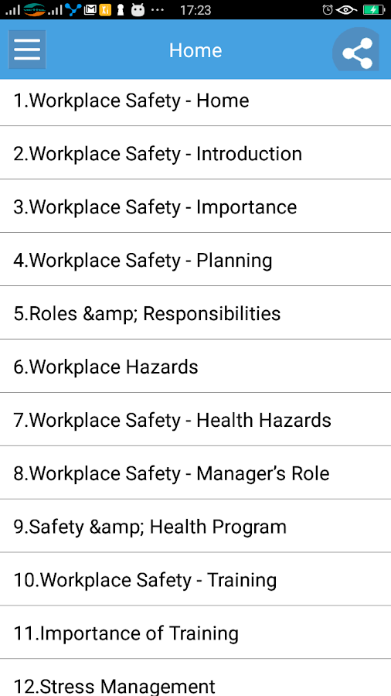
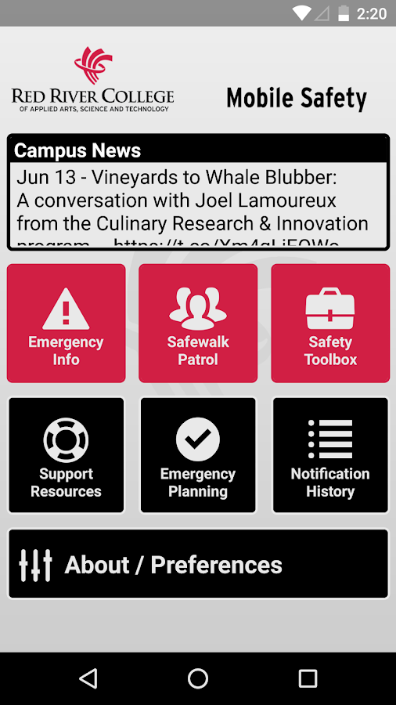
Existing applications
Learn Workplace Safety
In-depth guide to health and safety
Identifies hazards and risks
Simple and easy navigation
Free
Mobile Safety
Several useful tools
Student safety top priority
Available to staff AND students
Retrieved from: https://play.google.com/store/apps/details?id=com.appsgooder.workplacesafety
Retrieved from: https://play.google.com/store/apps/details?id=com.cutcom.apparmor.rrc

Slide 10
Software Technologies and Methodology

Slide 11
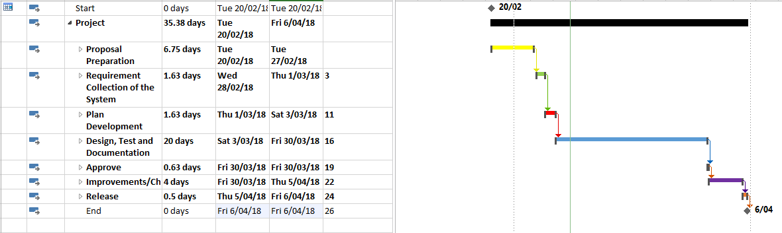
Gantt chart

Slide 12
What’s next?
Meeting with health and safety officer
01
Final design of application
02
Coding!
03

Slide 13

Questions?

Slide 14
References
Health and Safety. (n.d.). Retrieved from English Oxford Living Dictionaries: https://en.oxforddictionaries.com/definition/health_and_safety

